Slide 1
Software Systems Design and Integration
Lecture 10, Part I
EJB Component Model

Slide 2
Aims
To understand the role of EJB components in the software architecture of Enterprise Web Applications
To be able to describe the EJB Component Model in Java EE
To have an idea of the technology stack needed for developing and deploying EJBs

Slide 3
Content
Role of EJBs in Java Enterprise Applications
Lifeline and Anatomy of the Beans
Calling EJBs from other Java EE Components

Slide 4
1 Role of EJBs in Enterprise Applications
Software components that live within the EJB container of application server
Based on the RMI model of Java
Their role within Java Enterprise applications is to
  Implement the business logic of data processing through exposing remote methods
  Provides mechanisms for data encapsulation, serialization and transportation of the data for remote server-side data processing
  Support security, multi-threading and scalability of the remote data processing

Slide 5
1.1 Types of EJBs
Session Beans
Message Beans
Entity Beans
Stateful - maintain state of the data
Session support - track the source of the calls
Synchronous -expose remote methods
Only within the EJB container
No state - the messages are self contained
No session – all messages go to the same queue
Asynchronous - no remote methods
Extra queuing mechanism
Only within the EJB container
No state
No session
Encapsulate the data
Serialize the data
Previously part of Java EE, now part of Java SE – both client-side and server-side

Slide 6
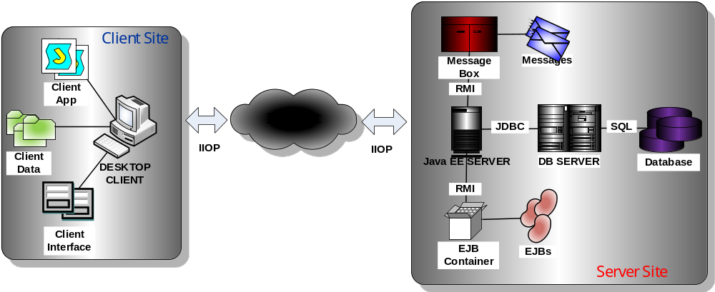
1.2 Scenarios of using EJBs in Java EE Applications
Remote Desktop EJB Client

Slide 7
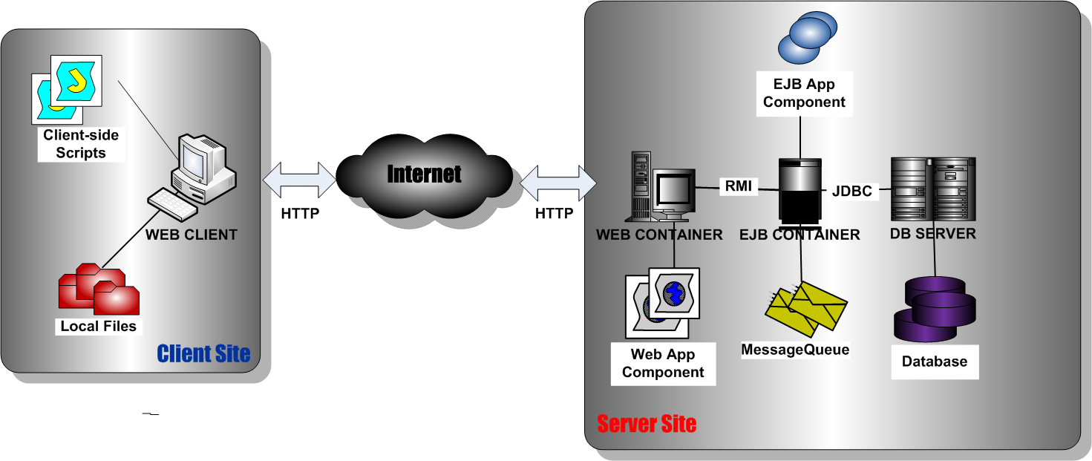
Local server-side EJB client

Slide 8
1.3 Splitting EJBs into Tiers
The separation is purely logical - all beans run within the same EJB container
    The tiers allows better design of the software architecture – separate tiers deal with the interaction with the front-end, the interaction with the backend and the business logics in the middle
  Multi-tier applications in Java EE applications are typically organised in a closed software architecture – no database interaction from every tier, just from the backend!
  Exception: Read-only data from the front-end tier

Slide 9
Typical EJB tears
Service tier: session beans as façade (after the session facade design pattern), session beans for synchronous calls to business methods and message beans for asynchronous messages
Object-relational mapping tier (ORM): entity beans as local business data providers encapsulating the data
Enterprise Information System integration tear (EIS): data brokers and EIS adapters to legacy systems

Slide 10
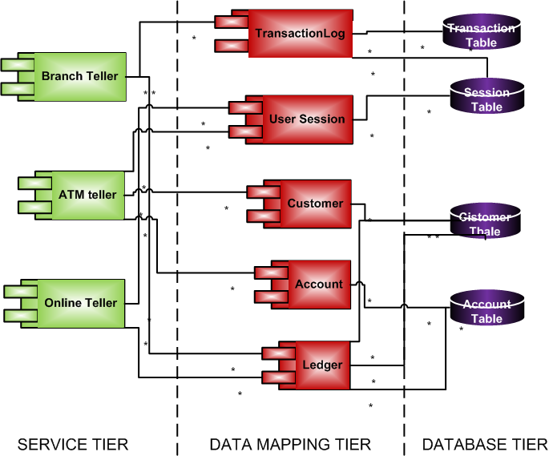
Example: Multi-tier Banking System

Slide 11
2 EJB Development
2.1 EJB methods and interfaces
Session Bean Implementations: The EJB class implements one of the two interfaces – javax.ejb.stateless or javax.ejb.stateful
Lifecycle methods: called by the container at different points of the lifecycle of the EJB component; the EJB component developer must implement them to allow the container to manage the EJB component automatically
Business logics methods: called remotely by an external client (desktop or server-side) or locally by another Java EE application component (Web container component such as servlet, or another EJB component such as session bean)

Slide 12
EJB Component Interfaces: common for all EJBs
  EJBContext Interface – provides access to the context of execution, similarly to ServletContext in the case of Web container and specifies security, transaction and lookup methods
  SessionContext and MessageDrivenContext – extends EJBContext with methods specific for each type of bean (session or message)
Remote Component Interface: Based on the proxy pattern – the proxy client on the client-side is talking to the EJBObject on the server-side via the container
To locate the remote interface for the object of interest the client must look up into the JNDI registry to find the proxy of the EJB component

Slide 13
2.2 Accessing an EJB Component from a Client
Via its local interfaces – from servlets within the Web container, or other EJBs within the same EJB container (local RMI calls)
Via its remote interfaces – from desktop clients, or EJBs within different containers (remote calls over IIOP)
Via its Web service interfaces – from Web service clients (remote calls over HTTP)
Without interfaces (Only for public methods) – from Java object within the same JVM (native Java calls)

Slide 14
2.3 Role of the EJB Container
Exposes the EJB components, providing proxies for remote invocation of their methods
Maps the client calls to the remote methods of the beans to the corresponding method implementations
Encapsulates the access to external resources used by the bean (databases, legacy systems, etc.)
Manages the beans lifecycle using lifecycle methods
Maintains sessions to allow programmatic control of the information flows
Provides timer services to allow the beans to perform scheduler tasks automatically
(For message beans only) Monitors the message queues on behalf of the message EJB and automatically invokes the message processing methods upon arrival

Slide 15
2.4 Preserving the thread safety when using EJBs in Java EE Components
If you are calling stateless EJB (i.e., for business data processing) from within a servlet, the servlet remains tread safe, because all calls to the business methods of the bean are tread safe
If you are calling stateful EJB (i.e., data placeholder), the servlet needs to be synchronized because the bean will initiate its own session (typical example – the servlet uses a stateful bean from a pool to connect to database)
If in several components you access one and the same stateful bean concurrently, it will be automatically serialized by the container to preserve the tread safety
If you are storing a reference to an EJB in an instance variable within the bean itself, this can also potentially compromise the tread safety and should be avoided

Slide 16
3 Calling EJB components from remote clients
Calls to the EJBs can be made from desktop application clients over IIOP
The desktop applications can be deployed to the same host or to a remote host
They run within different JVM so JNDI lookup is necessary
If the desktop application making the call is on the same host, JNDI lookup against local JNDI registry is sufficient, otherwise remote calls to JNDI registry is needed

Slide 17
Example: remote access to a bank application from a desktop client
BankMgr bMgr;
try {
Properties props = new Properties();
// URL of the remote server
props.put(Context.PROVIDER_URL,
"iiop://srv.ibank.com:7676");
// locating the registry on the server
InitialContext ic = new InitialContext(props);
// looking up for the remote bean proxy
bMgr=(BankMgr)ic.lookup(“java:comp/env/ejb/BankMgr”);
}

Slide 18
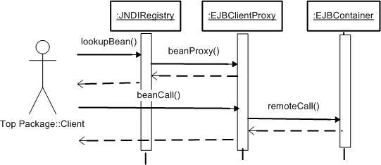
Sequence Diagram of the interactions

Slide 19
Example: Using annotations to obtain local reference to EJBs
@EJB private BankMgr bMgr
No need for JNDI lookup if called locally - the container automatically assigns a value to the reference
The JNDI registration of the bean is done automatically by the container for providing remote invocation of the exposed methods via the bean proxy
The container also prevents exception throwing during initialization of the components, which may call the remote methods of the bean

Slide 20
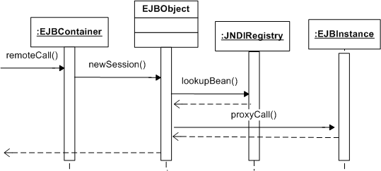
Sequence Diagram of the Interactions

Slide 21
4 Calling EJB components from other
Java EE components
The servlets and EJBs can call the EJB beans deployed to the same Java EE server in the same Java EE app as Java classes (call by name)
If the components are part of a different Java EE app deployed to the same server, they need to use reference to the bean which can be specified using in-line annotation (dependency injection); in such a case the server uses its own reference to the EJB (call by nickname)
If the servlets are deployed to a different Java EE server, they are very much like desktop apps and must obtain JNDI reference to the EJB prior to its use (call by proxy)

Slide 22
4.1 Obtaining reference to EJBs in servlets
The EJBs are automatically registered by the EJB container in the JNDI registry during deployment
Obtaining the reference to the EJBs can be done during initialization of the servlets to avoid lookups during runtime, which are time consuming
The references can be placed in instance variables for future use within the servlets
Since the lookup can throw exceptions, it must be caught and managed using suitable servlet exception to prevent the servlet from dying

Slide 23
Example: Accessing an EJB component from within a remote servlet
BankMgr bMgr;
public void init(){
try {
InitialContext ic = new InitialContext();
// looking up for the remote bean proxy
bMgr=
(BankMgr)ic.lookup(“java:comp/env/ejb/BankMgr”);
} catch(Exception e) {
throw new ServletException (e);
}
}

